Slide 1
Implementing CSS
05
I399 Web Development

Slide 2
CSS Resources
http://jigsaw.w3.org/css-validator/
Validates your CSS for correctness and checks for syntax errors.
https://developer.mozilla.org/en-US/docs/Web/CSS
CSS Reference and Examples

Slide 3

Selectors: Class vs ID
id
unique
like a serial number
class
not unique
reusable which means
many copies possible
like a barcode
http://css-tricks.com/the-difference-between-id-and-class/

Slide 4
Selectors
p.warning { }
matches all paragraphs with a class called ‘warning’
#example { }
matches the element with an id called ‘example’
p.info, li.highlight { }
matches paragraphs with a class called ‘info’ and also list items with a class called ‘highlight’

Slide 5
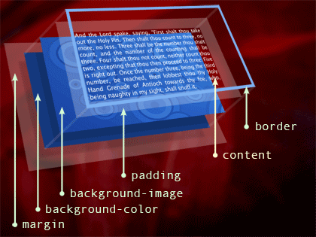
The Box Model

Slide 6
The Box Model:
Border, Margin, and Padding
Border (edge of the box)
The invisible outside of the HTML box created by a block-content element. Can be made visible.
Margin (area outside of the box)
Controls the positioning and placement of the box (block-content element).
Padding (area inside the box, between the border and the content)
Controls the space between the edge of the container (margin/border) and the edge of your content.

Slide 7
Finding the width without the fix
You will frequently want an HTML element to be a specific width. Although the width can be set in CSS, changing the amount of padding or margin or adding a visible border affect the TOTAL width. Width should be set to that true value or it won't display like you think it should.
width = 600px;
padding = 25px;
margin= 70px;
border = 5px;
Actual Width = 800px
CONTENT CONTENT CONTENT CONTENT CONTENT CONTENT
width set by styles
width displayed on screen

Slide 8
Finding the width WITH the fix
With the fix we will use in class, and is often used now by many frameworks, you can set the variables related to a box and the content size will adjust
= LESS MATH
width = 600px;
padding = 25px;
margin= 70px;
border = 5px;
Actual Width = 600px
(content width = 400px)
CONTENT CONTENT CONTENT CONTENT CONTENT CONTENT
width set by styles
width displayed on screen

Slide 9
Natural Box Layout Model
/* apply a natural box layout model to all elements */
html { box-sizing: border-box; } *, *:before, *:after { box-sizing: inherit; }
https://css-tricks.com/box-sizing/

Slide 10
Box properties may be set individually or together in CSS
padding-top: 20px;
padding-right: 35px;
padding-bottom: 50px;
padding-left: 35px;
padding: 20px 35px; (vertical | horizontal)
padding: 20px 35px 50px; (top | horizontal | bottom)
padding: 20px 35px 50px 35px; (top | right | bottom | left)
top
left
right
bottom

Slide 11

Top
Right
Bottom
Left

Slide 12
Center alignment
Positioning margin: 0 auto;
Works for ‘block-level’ HTML elements, usually a <div> or positioning element. The width must be previously set for this to work. (If no width is set, the container will default to 100% width, and you won't see anything change.)
Text
text-align: center;
Works for text content.
ALWAYS REMEMBER
<center> == BAD

Slide 13
Centering images
To position an image, place it within a <div>, <figure> or other block level element and then position THAT CONTAINER ELEMENT.
HTML
<figure class="center-align">
<img src="images/kittens.jpg">
<figcaption>We love kittens!</figcaption>
</figure>
CSS
.center-align { margin: 0 auto; width: 75%; }

Slide 14
Resources
HTML5 Shiv:
https://github.com/aFarkas/html5shiv
Normalize.css: https://necolas.github.io/normalize.css/

